Slide 1
CSE 6406 - BIOINFORMATICS ALGORITHMS
CSE 463 - INTRODUCTION TO BIOINFORMATICS
CSE 495 - BIOINFORMATICS
GENOME REARRANGEMENTS
Week #2

Slide 2
Outline
Genome Rearrangements
Sorting By Reversals
Pancake Flipping Problem
Greedy Algorithm for Sorting by Reversals
Approximation Algorithms
Breakpoint Graphs
Content mostly taken from
Pevzner’s original slides

Slide 3
Genome rearrangements
Alfred Sturtevant studied fruit fly mutants with
  Scarlet and peach-colored eyes
  Abnormally shaped deltoid wings.
Sturtevant analyzed the genes coding for these traits (called scarlet, peach, and delta)
  Drosophila melanogaster → (scarlet, peach, delta) differed
  Drosophila simulans → (scarlet, delta, peach)
Conjecture: The chromosomal segment containing peach and delta must have been flipped around

Slide 4
Genome rearrangements
Salivary glands of Drosophila contain polytene cells
Sturtevant & Dobzhansky looked at polytene chromosomes under a microscope and witnessed the work of rearrangements first hand in tangled mutant chromosomes
They published the evolutionary tree presenting a rearrangement scenario with seventeen reversals for various species of Drosophila, the first evolutionary tree in history to be constructed based on molecular data.
Notes:
Polytene cells. In normal cellular division, each daughter cell receives one copy of the genome. However, in the nuclei of polytene cells, DNA replication occurs repeatedly in the absence of cell division. The resulting chromosomes then knit themselves together into much larger “superchromosomes” called polytene chromosomes.
Polytene chromosomes serve a practical purpose for the fruit fly, which uses the extra DNA to boost the production of gene transcripts, producing lots of sticky saliva.

Slide 5
Genome rearrangements

Slide 6
Genome rearrangements

Slide 7
Genome rearrangements

Slide 8
Genome rearrangements

Slide 9
Genome rearrangements
Before
After

Slide 10
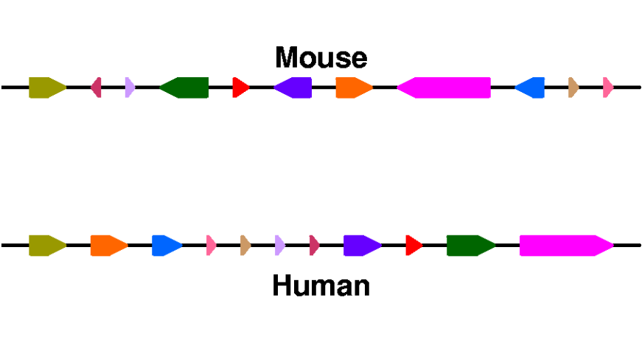
Genome rearrangements
Mouse (X chrom.)
Unknown ancestor
~ 75 million years ago
Human (X chrom.)
What are the similarity blocks (Synteny blocks) and how to find them?
What is the architecture of the ancestral genome?
What is the evolutionary scenario for transforming one genome into the other?

Slide 11
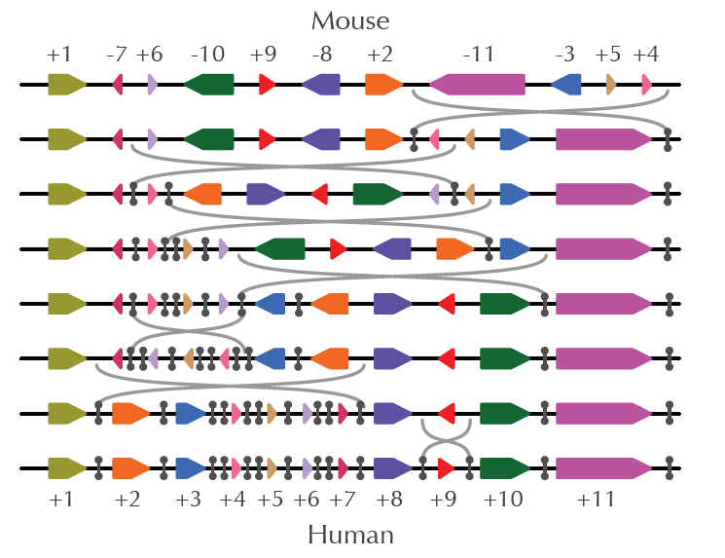
Genome rearrangements (cont)

Slide 12
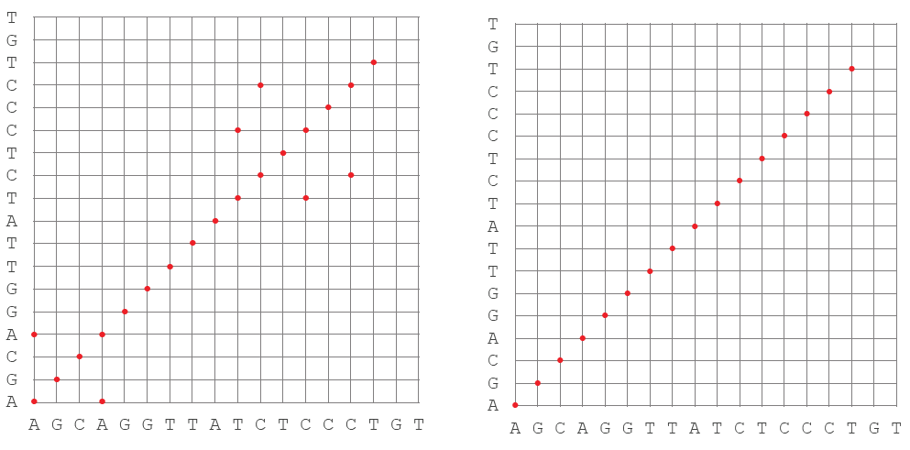
Finding synteny blocks! (Genome dot plot)
Notes:
visualization of repeated k-mers within the string AGCAGGTTATCTCCCTGT for k = 2 (left) and k = 3 (right).

Slide 13
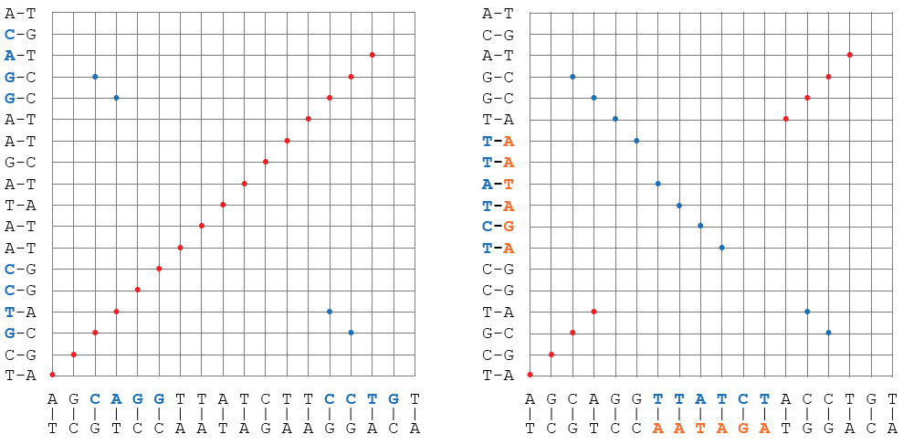
Genome dot plot
Notes:
(Left) We add blue points to the plot shown in the upper left corner to indicate reverse complementary k-mers. For example, CCT and AGG are reverse complementary 3-mers in AGCAGGTTATCTTCCTGT.
(Right): Genomic dot-plot showing shared 3-mers between AGCAGGTTATCTACCTGT and AGCAGGAGATAAACCTGT. The latter sequence resulted from the former sequence by a reversal of the segment TTATCT. Each point (x, y) corresponds to a k-mer shared by the two genomes. Red points indicate identical shared k-mers, whereas blue points indicate reverse complementary k-mers. Note that the dot-plot has six “noisy” blue points in the diagram: four in the upper left corner, and two in the bottom right corner. You will also notice that red dots can be connected into line segments with slope 1 and blue dots can be connected into line segments with slope −1. The resulting three synteny blocks (AGCAGG, TTATCT, and ACCTGT) correspond to three diagonals (each formed by four points) in the dot-plot.

Slide 14
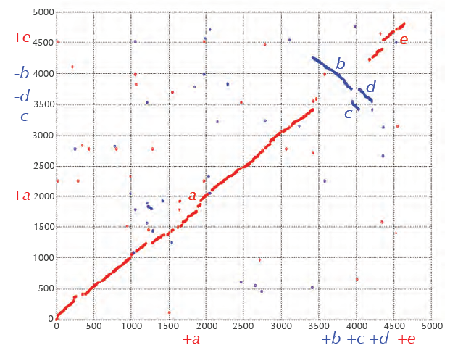
Genome dot plot
Notes:
Genomic dot-plot of Escherichia coli (horizontal axis) and Salmonella enterica (vertical axis) for k = 30. Each point (x, y) corresponds to a k-mer shared by the two genomes.
Red points indicate identical shared k-mers, whereas blue points indicate reverse complementary k-mers. Each axis is measured in kilobases (thousands of base pairs).

Slide 15
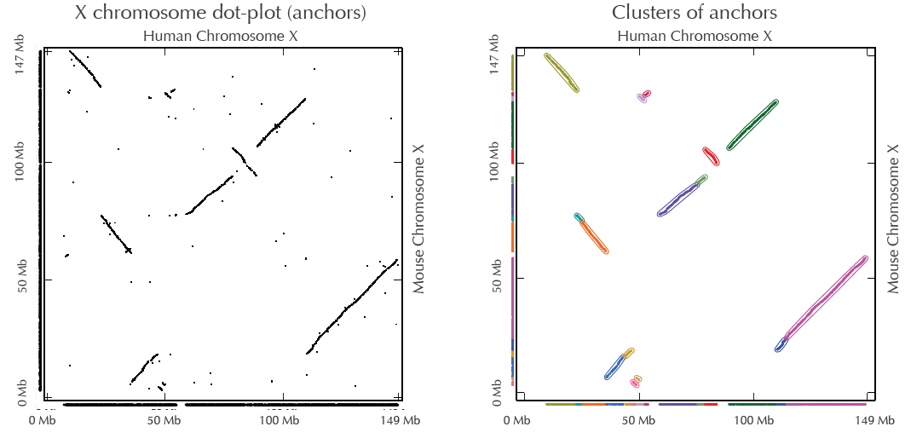
Finding synteny blocks
(Human vs Mice)
Notes:
(Left) The genomic dot-plot for the human and mouse X chromosomes, representing all positions (x, y) where they share significant similarities. Here, we do not distinguish between red and blue dots.
(Right) Clusters (connected components) of points in the genomic dot-plot are formed by constructing the synteny graph.

Slide 16
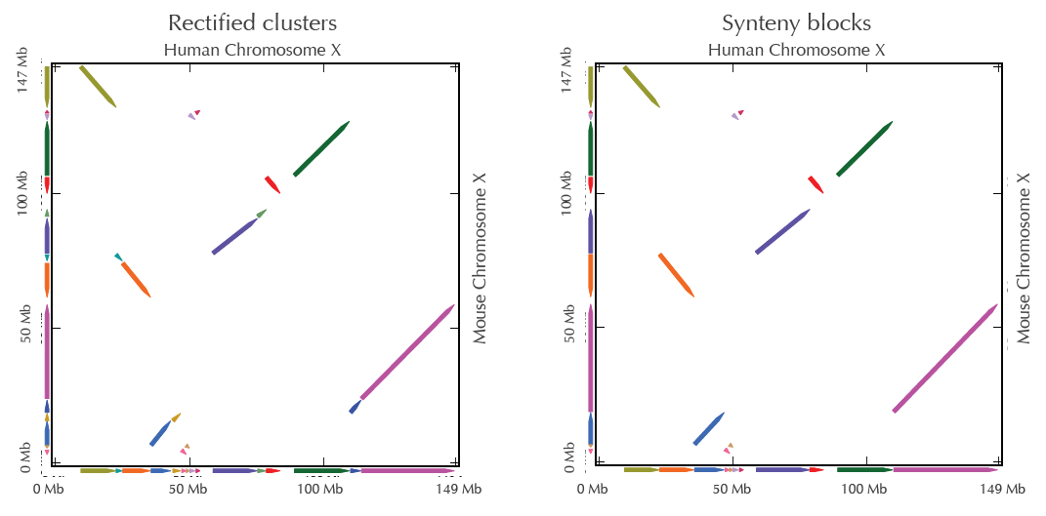
Finding synteny blocks
(Human vs Mice)
Notes:
(Left) Rectified clusters from the synteny graph transform each cluster into an exact diagonal of slope ±1.
(Right) Aggregated synteny blocks. Projection of the synteny blocks to the x-and y-axes results in the arrangements of synteny blocks in the respective human and mouse genomes (+1 +2 +3 +4 +5 +6 +7 +8 +9 +10 +11) and (+1 -7 +6 -10 +9 -8 +2 -11 -3 +5 +4).

Slide 17
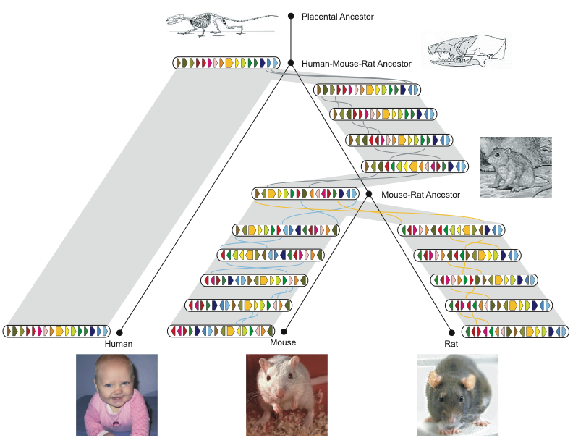
History of Chromosome X
Rat Consortium, Nature, 2004
Notes:
Why is the gene content of mammalian X chromosomes so conserved? [See page 340 of text book]

Slide 18
The Random Breakage Model of Chromosome Evolution
Proposed by Susumu Ohno in 1973
breakage points of rearrangements are selected randomly
  There are no rearrangement hotspots in mammalian genomes
In 1984, Joseph Nadeau and Benjamin Taylor offered a proof.

Slide 19
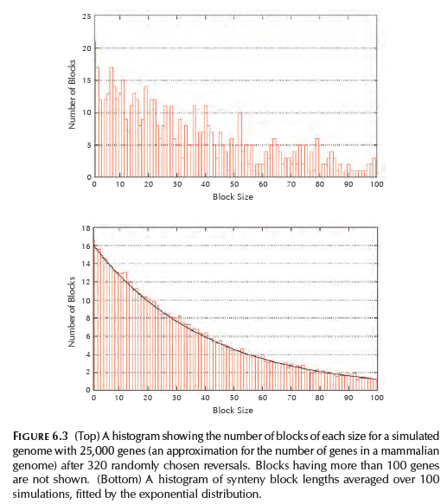
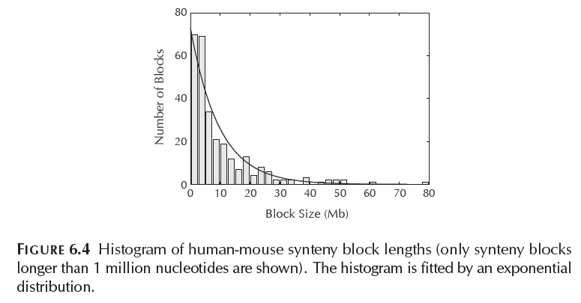
The Random Breakage Model of Chromosome Evolution

Slide 20
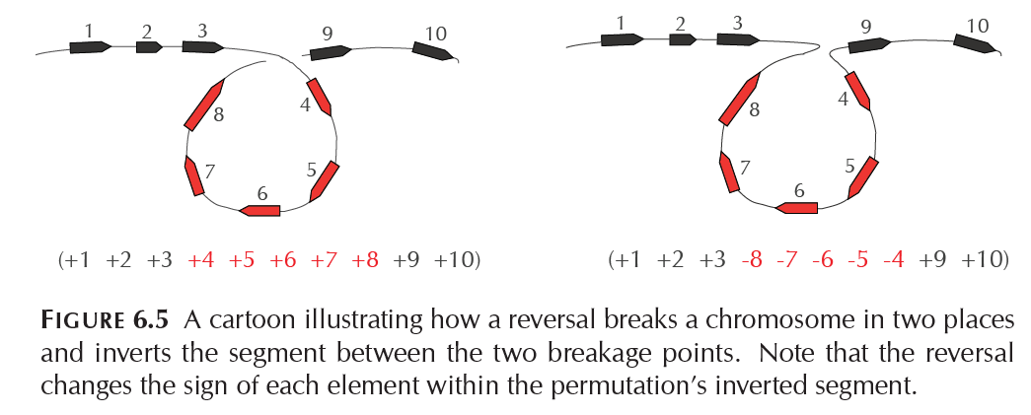
Reversals

Slide 21
Reversals: Example
π = 1 2 3 4 5 6 7 8
ρ(3,5)
1 2 -5 -4 -3 6 7 8

Slide 22
Reversals: Example
π = 1 2 3 4 5 6 7 8
ρ(3,5)
1 2 -5 -4 -3 6 7 8
ρ(5,6)
1 2 -5 -4 -6 3 7 8

Slide 23
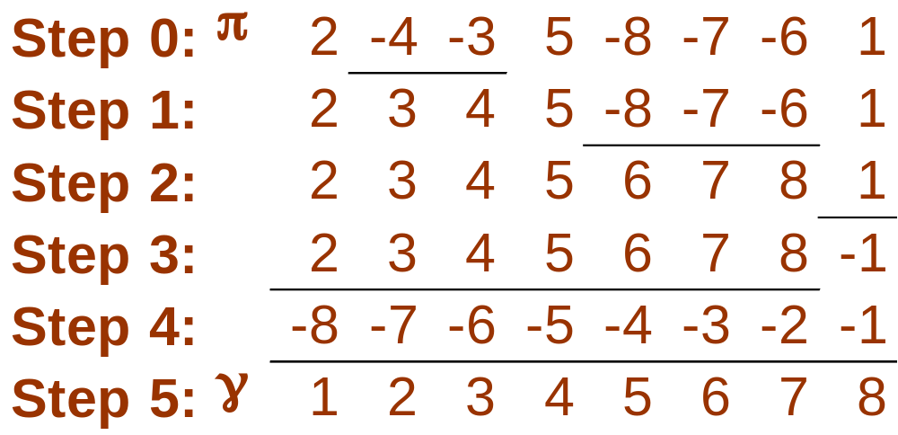
Sorting by reversals: 5 steps

Slide 24
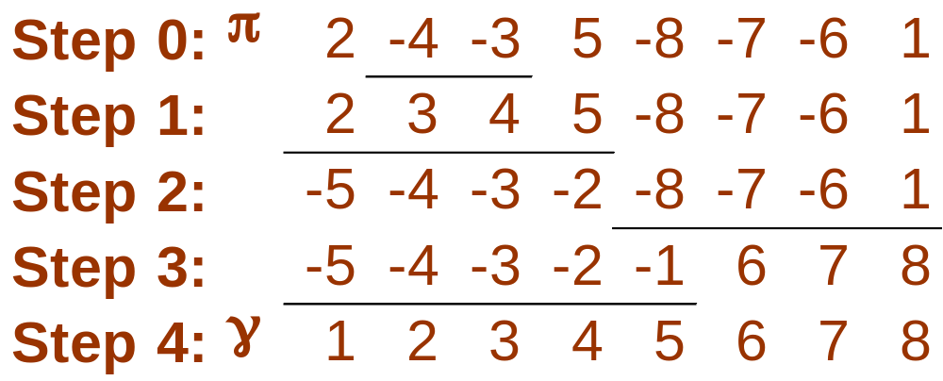
Sorting by reversals: 4 steps

Slide 25
Sorting by reversals: 4 steps
What is the reversal distance for this permutation? Can it be sorted in 3 steps?

Slide 26
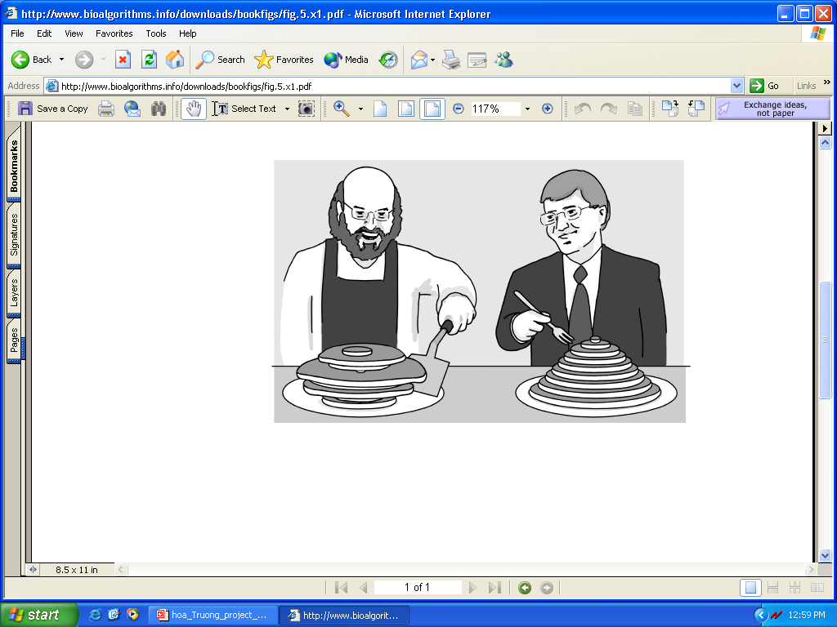
Pancake Flipping Problem
The chef is sloppy; he prepares an unordered stack of pancakes of different sizes
The waiter wants to rearrange them (so that the smallest winds up on top, and so on, down to the largest at the bottom)
He does it by flipping over several from the top, repeating this as many times as necessary
Christos Papadimitrou and Bill Gates flip pancakes

Slide 27
Pancake Flipping Problem: Formulation
Goal: Given a stack of n pancakes, what is the minimum number of flips to rearrange them into perfect stack?
Input: Permutation π
Output: A series of prefix reversals ρ₁, … ρ_{t} transforming π into the identity permutation such that t is minimum

Slide 28
Pancake Flipping Problem: Greedy Algorithm
Greedy approach: 2 prefix reversals at most to place a pancake in its right position, 2n – 2 steps total at most
William Gates and Christos Papadimitriou showed in the mid-1970s that this problem can be solved by at most 5/3 (n + 1) prefix reversals

Slide 29
Sorting By Reversals: A Greedy Algorithm
If sorting permutation π = 1 2 3 6 4 5, the first three elements are already in order so it does not make any sense to break them.
The length of the already sorted prefix of π is denoted prefix(π)
  prefix(π) = 3
This results in an idea for a greedy algorithm: increase prefix(π) at every step
Notes:
We say that element k in permutation P = (p₁ . . . p_{n}) is sorted if p_{k} = +k and unsorted otherwise.
We call P k-sorted if its first k elements are sorted, but if element k+1 is unsorted.
For every (k - 1)-sorted permutation P, there exists a single reversal, called the k-sorting reversal, that fixes the first (k -1) elements of P and moves element k to the k-th position.
In the case when -k is already in the k-th position of P, the k-sorting reversal merely flips –k around.

Slide 30
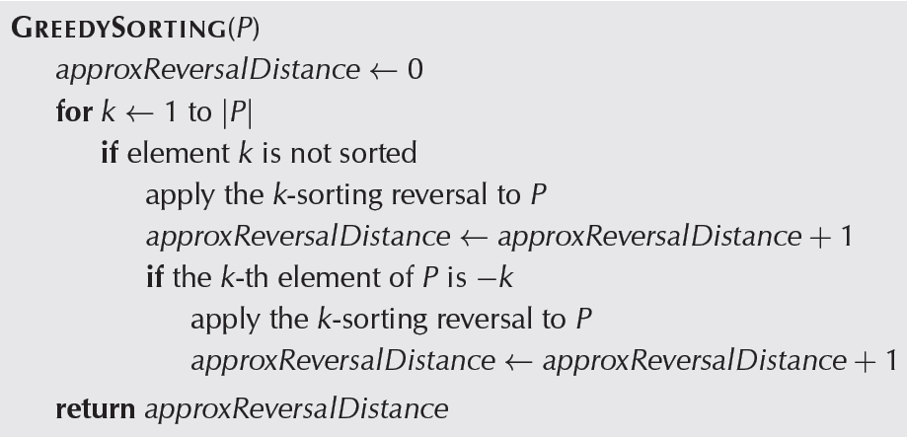
Greedy Sorting
Notes:
We say that element k in permutation P = (p₁ . . . p_{n}) is sorted if p_{k} = +k and unsorted otherwise.
We call P k-sorted if its first k elements are sorted, but if element k+1 is unsorted.
For every (k - 1)-sorted permutation P, there exists a single reversal, called the k-sorting reversal, that fixes the first (k -1) elements of P and moves element k to the k-th position.
In the case when -k is already in the k-th position of P, the k-sorting reversal merely flips –k around.

Slide 31
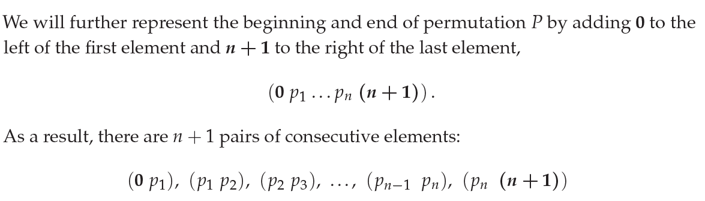
Adjacencies and Breakpoints
Consecutive elements (p_{i} p_{i}+1) in permutation
P = (p_{1,} p₂ . . . P_{n}) form an adjacency if
p_{i+1} – p_{i} = 1

Slide 32
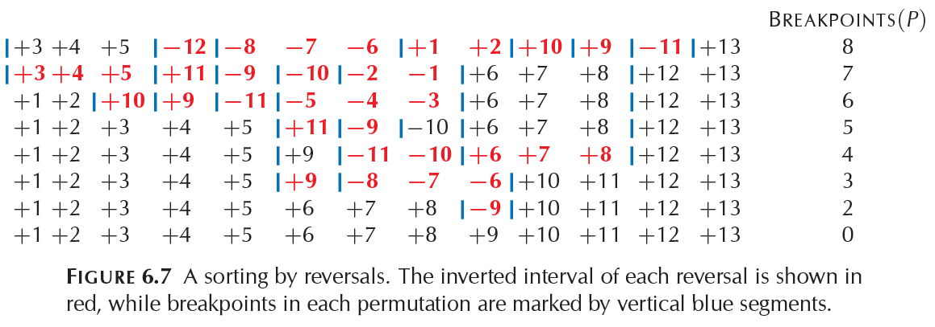
Adjacencies and Breakpoints
Breakpoint Theorem
d_{rev}(P) >= BREAKPOINTS(P)/2

Slide 33
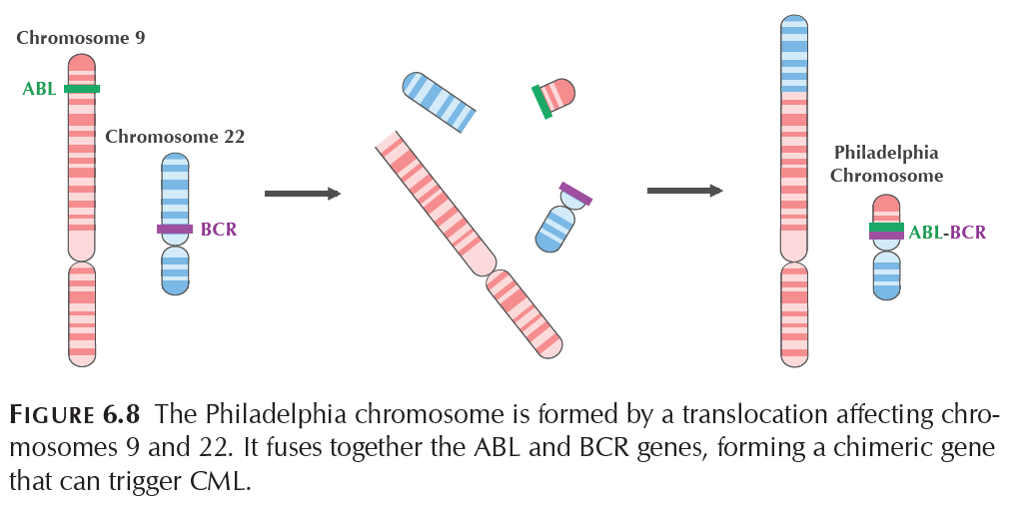
Rearrangements in Tumor Genomes
Notes:
See pages 310-311
CML - Chronic Myeloid Leukemia
ABL-BCR fusion protein
Gleevec inhibits ABL-BCR fusion protein

Slide 34
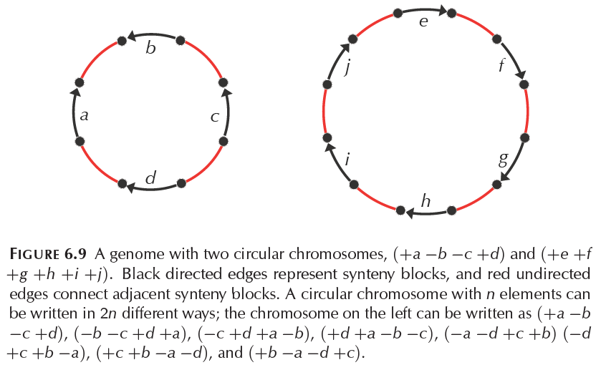
Genome graph
Notes:
In this model, the human genome can be represented using 280 human-mouse synteny blocks spread over 23 alternating cycles.

Slide 35
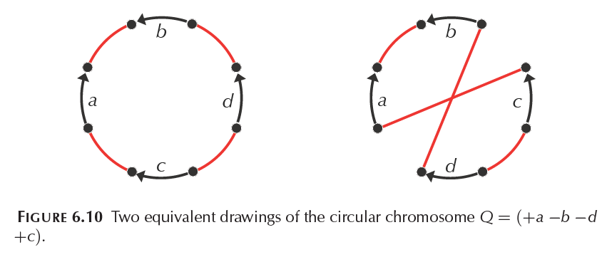
Genome graph

Slide 36
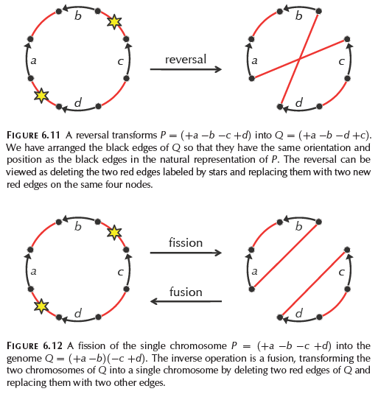
Genome Rearrangements
Notes:
2-break. We define the general operation on the genome graph in which two red edges are replaced with two new red edges on the same four nodes as a 2-break.
2-break distance. We would like to find a shortest sequence of 2-breaks transforming genome P into genome Q, and we refer to the number of operations in a shortest sequence of 2-breaks transforming P into Q as the 2-break distance between P and Q, denoted d(P,Q).
Chimpanzees has 24 chromosomes whereas humans have 23 chromosomes. This is explained through fusion

Slide 37
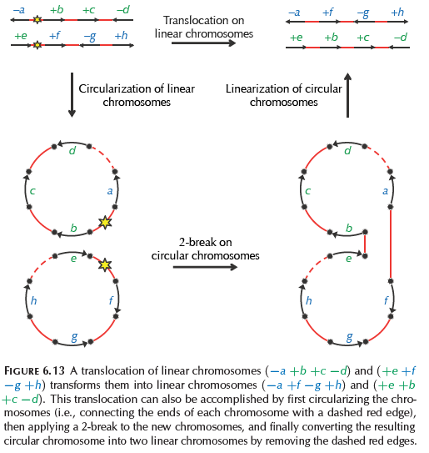
Genome Rearrangements

Slide 38
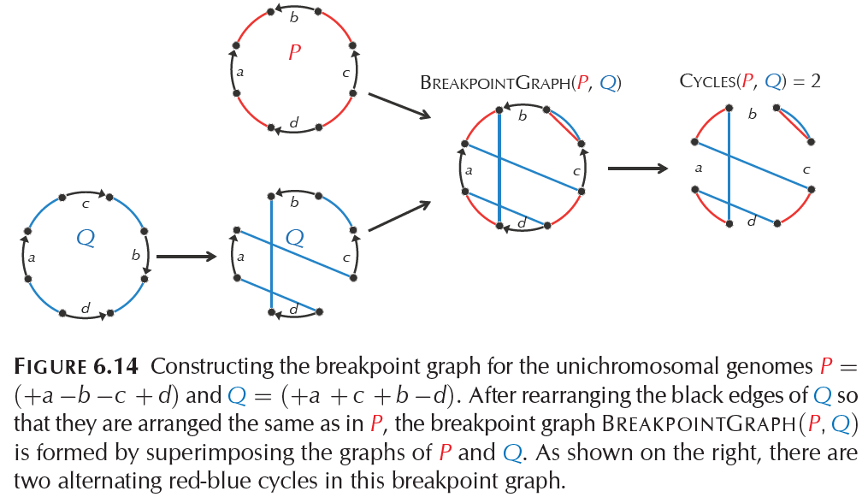
Breakpoint Graphs

Slide 39
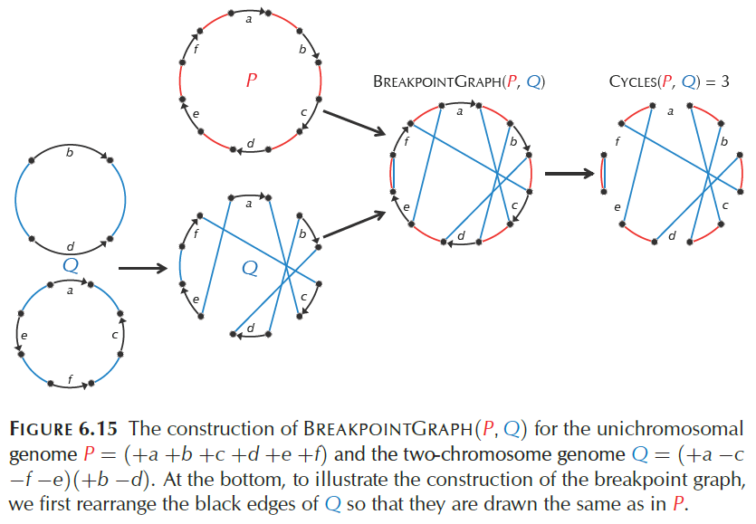
Breakpoint Graphs

Slide 40
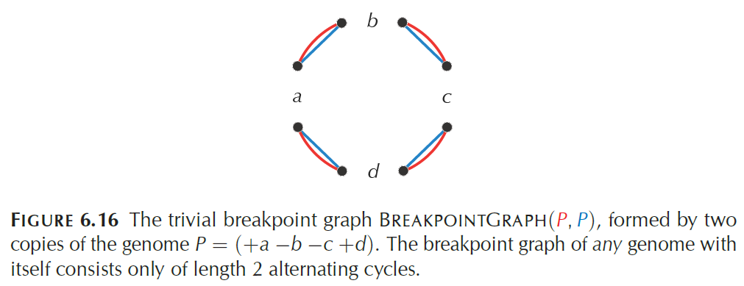
Breakpoint Graphs

Slide 41
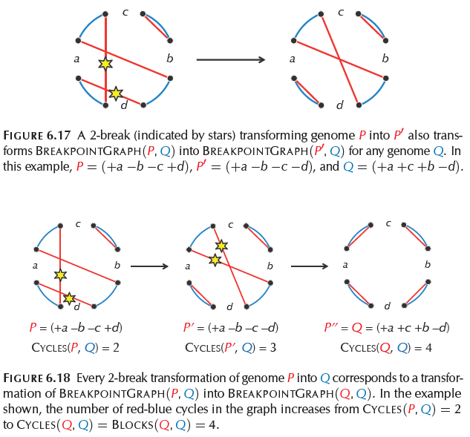
Breakpoint Graphs
Notes:
Figure 6.18 illustrates a transformation of a breakpoint graph with CYCLES(P,Q) = 2 into a trivial breakpoint graph with CYCLES(Q,Q) = 4 using
two 2-breaks.

Slide 42
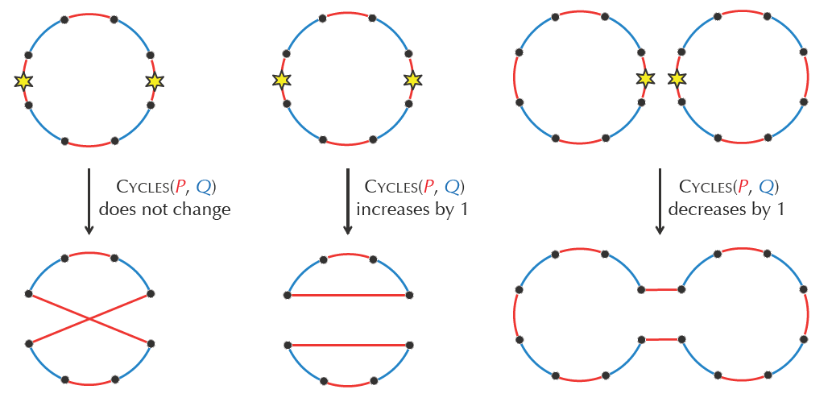
Cycle Theorem
For genomes P and Q, any 2-break applied to P
can increase CYCLES(P,Q) by at most 1
Notes:
Proof
A 2-break adds two new red edges and thus forms at most 2 new cycles (containing two new red edges) in BREAKPOINTGRAPH(P,Q).
At the same time, it deletes two red edges and thus deletes at least 1 old cycle (containing two old edges) from BREAKPOINTGRAPH(P,Q).
Thus, the number of red-blue cycles in the breakpoint graph increases by at most 2.

Slide 43
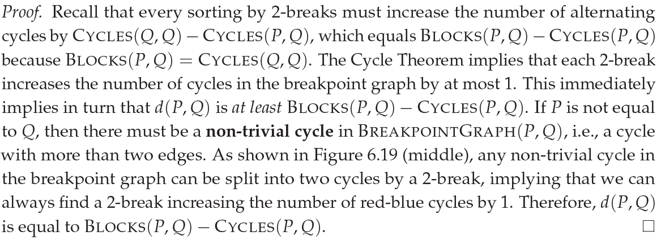
2-Break Distance Theorem
The 2-break distance between genomes P and Q
is equal to BLOCKS(P,Q) – CYCLES(P,Q)
Can you design an algorithm to list a series of 2-Breaks
for transforming one circular genome into another?
Notes:
Solving the reversal distance problem for single linear chromosomes.
It turns out that a polynomial algorithm for sorting permutations by reversals does exist, yielding an exact formula for the reversal distance!
Although this algorithm also relies on the notion of the breakpoint graph, it is unfortunately too complicated to present

Slide 44
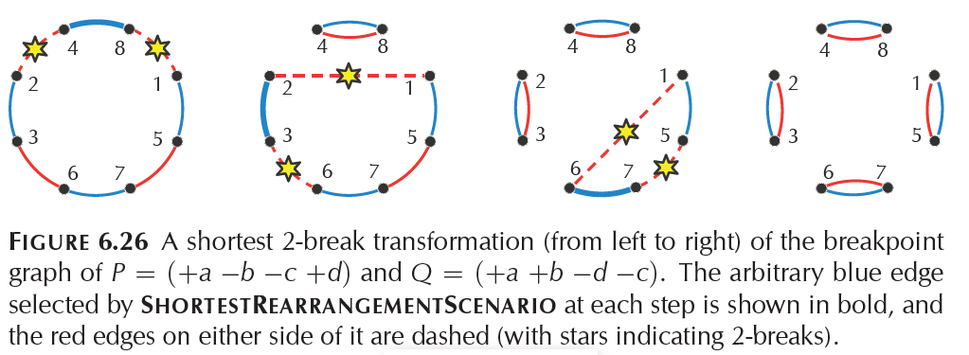
Transforming one circular genome into another

Slide 45
2-Break Distance Theorem
The 2-break distance between genomes P and Q is equal to BLOCKS(P,Q) - CYCLES(P,Q)
The breakpoint graph constructed on the 280 human-mouse synteny blocks contains 35 alternating cycles
  2-break distance between these genomes is atleast
  280 – 35 = 245

Slide 46
Random Breakage Model Refuted
N random 2-breaks → 2N synteny blocks
For human mouse scenario (2N = 280), RBM suggests ~140 2-breaks.
2-Break distance theorem suggests at least 245 2-breaks

Slide 47
The Fragile Breakage Model
Every mammalian genome is a mosaic of long solid regions, which are rarely affected by rearrangements, as well as short fragile regions that serve as rearrangement hotspots and that account only for a small fraction of the genome. For humans and mice, these fragile regions make up approximately 3% of the genome.

Slide 48
Conclusion
Many biological theories are based on arguments that a mathematician would view as fallacious; the logical framework used in biology is quite different from that used in mathematics.

